Slide 1

Data Analysis Project on Hotel Reservations
- Ramdas B Yamgar

Slide 2
Steps
Create a Problem Statement.
Identify the data you want to analyze.
Clean the data and explore it.
Analyze the to get useful insights
Present the data in term of report or dashboards using visualization (Power BI).

Slide 3
Business problem
In recent years , City Hotel and Resort Hotel have seen high cancellation rates. Each hotel is now dealing with No. of issues as a result, including fewer revenues and less than ideal hotel rooms use.
To avoid cancellations rates in both hotels is our primary goal in order to increase the efficiency to generate revenue. and for us to offer through business advice to address problem.
The analysis of hotel booking cancellations as well as other factors that have no bearing on their business and yearly revenue generation are the main topic of this project.

Slide 4
Assumptions
No unusual occurences between 2015 to 2017 will have impact o the data used.
The information is still current and can be used to analyze hotel possible plans in an efficient manner
There are no unanticipated negatives to the hotel employing any advised techniques.
The hotels are not currently using any of the suggested solutions.

Slide 5
Research Questions
Which variables that really affect on hotel reservations cancellations?
How can we make hotel reservations cancellations better?
How will guide to assist in making pricing and marketing decision/promotion?

Slide 6
Hypothesis
More cancellations occur when prices are higher
When there is no longer waiting list , customers tend to cancel there reservations more frequently.
Maximum clients are coming from offline travel agents to make there reservations.

Slide 7
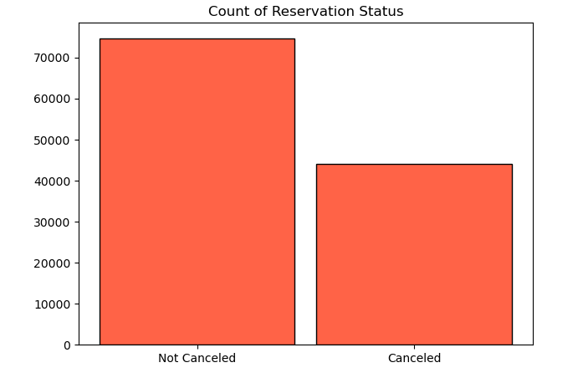
Analysis and Finding
The Bar-Graph shows the percentage of reservations that are canceled and not canceled.
There are still 37% of clients who canceled there reservations, which has a significant impact on hotel earning.
e

Slide 8
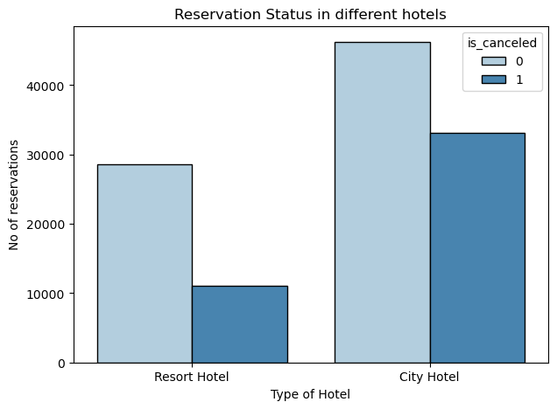
In comparison to Resort Hotel with City Hotel have more booking. It is possible that Resort Hotel are more expensive than the City Hotels
Reservation status in different Hotel.

Slide 9
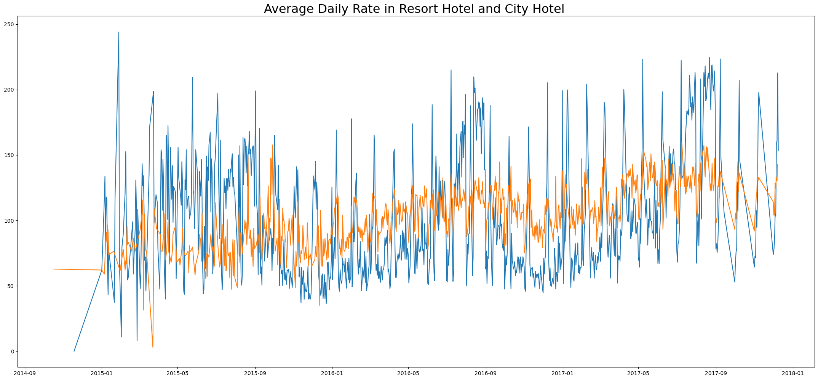
Average Daily Rate (ADR) in City vs Resort Hotel.
The Line-Graph shows that ADR with respect to days for city is less than resort hotel and other days ,it’s even more less. Which says that weekends and holidays may see increases rates of resort hotel

Slide 10
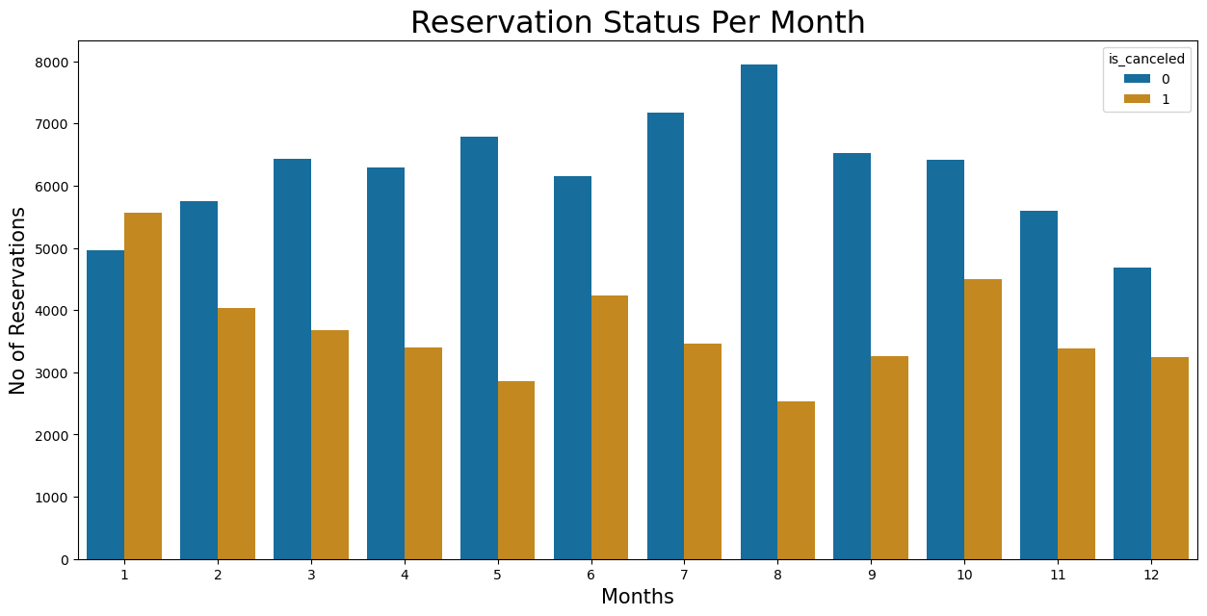
Reservations Status per Month
We developed grouped bar to analyze which months have maximum and minimum reservations levels according to reservation status.
As We see both No. of reservations confirmed and No. of reservations are canceled are maximum in month of August and Most canceled reservation occur in month of January.

Slide 11
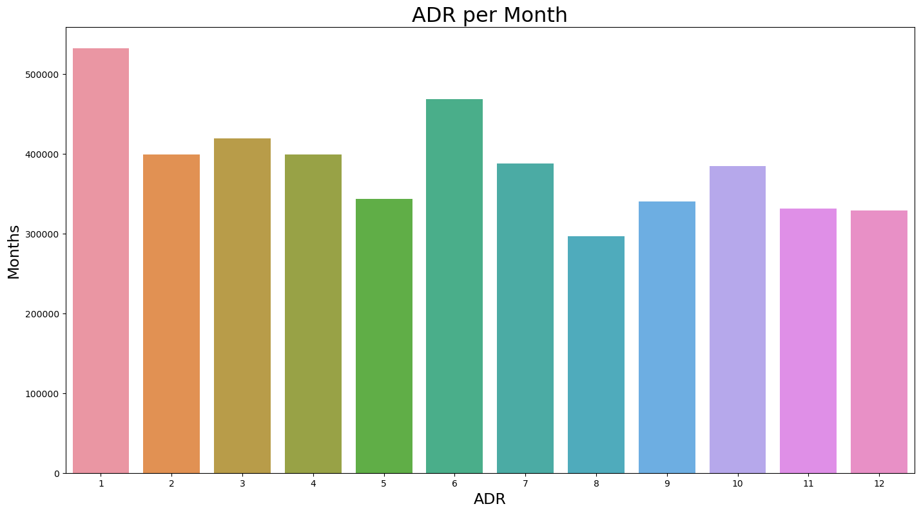
Average Daily Rate (ADR) each Month
The Bar-Graph shows that cancellations are most common when price are to much high and are least common when they are at low price.
Therefore, The cost of price of the accommodation is highly responsible for cancellation

Slide 12
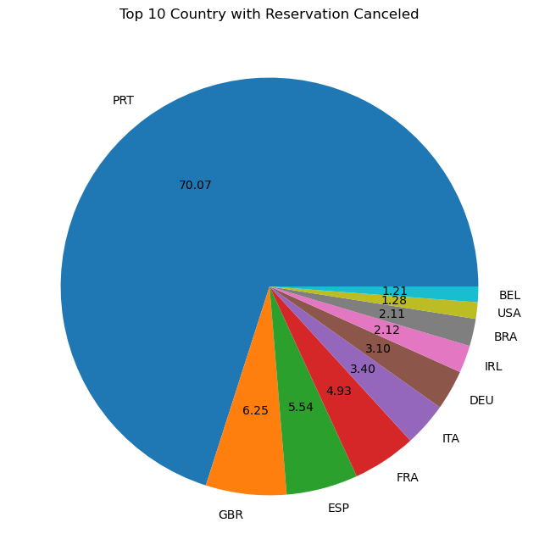
Top 10 Country with Reservation Canceled
The top country is Portugal with the highest number of cancellations

Slide 13
Suggestions
Cancellations rates rise when prices are high. To prevent cancellations of reservations of hotel could work on their pricing strategies and try to lower rates for specific hotels based on locations. And also provide Some discount to the customers.
The ratio of cancelled and not canceled of Resort Hotel is higher than City Hotel. So The hotels should provide reasonable rates on weekends and holidays.
In month of January , Hotel starts campaigns or marketing to increases their revenue as the cancellation are high in this month.
They can also increases the quality of their hotels and their services mainly in Portugal to minimize the cancellation rate.

